Slide 1
Food Walk

Slide 2
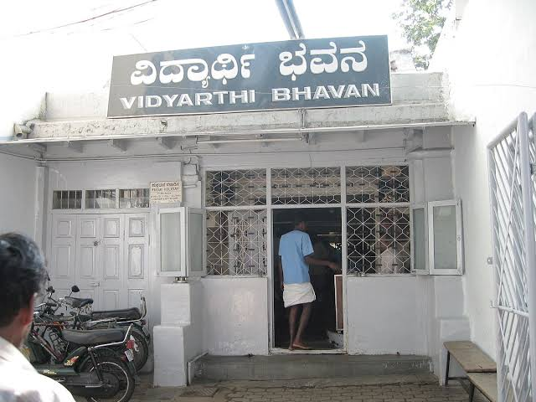
Vidhyarthi Bhavan
32, Gandhi Bazaar Main Rd, Gandhi Bazaar, Basavanagudi, Bengaluru,.
Karnataka 560004

Slide 3
About:
1970
Vidyarthi Bhavan was taken over by Ramakrishna Adiga ( village near Kundapur).
Unchanging taste
flavour & delicacy
Unchanged quality
Arun Kumar Adiga (quitting his Engineering job ) joined his father in 2005

Slide 4
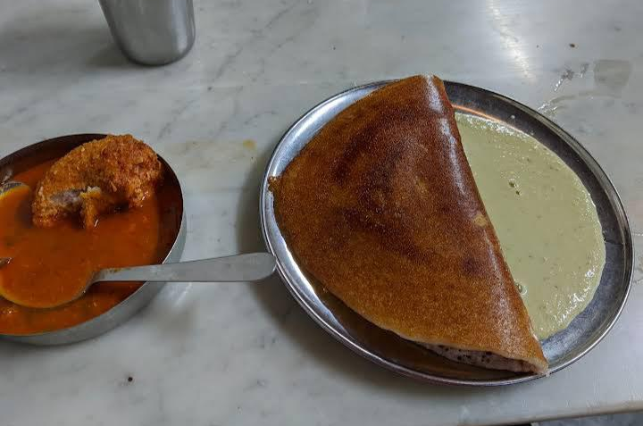
MASALA DOSA
NUTRITION
Calories: 40kcal
Carbo:hydrates: 6g
Protein: 2g
Fat: 1g
Saturated Fat: 1g
Sodium: 81mg
Potassium: 20mg
Fiber: 2g
Sugar: 1g
Vitamin A: 36IU
Vitamin C: 6mg
Calcium: 9mg
Iron: 1mg

Slide 5
Thank you

